Slide 1
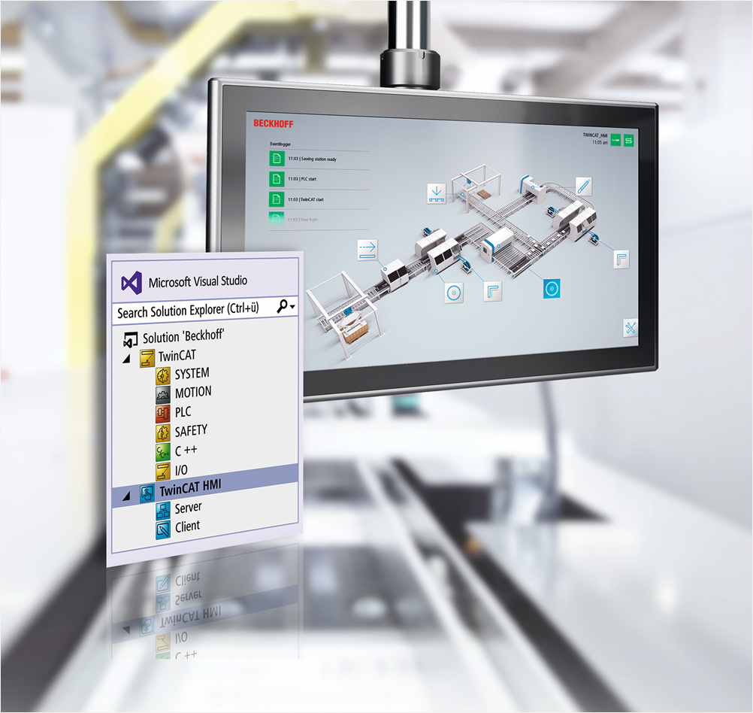
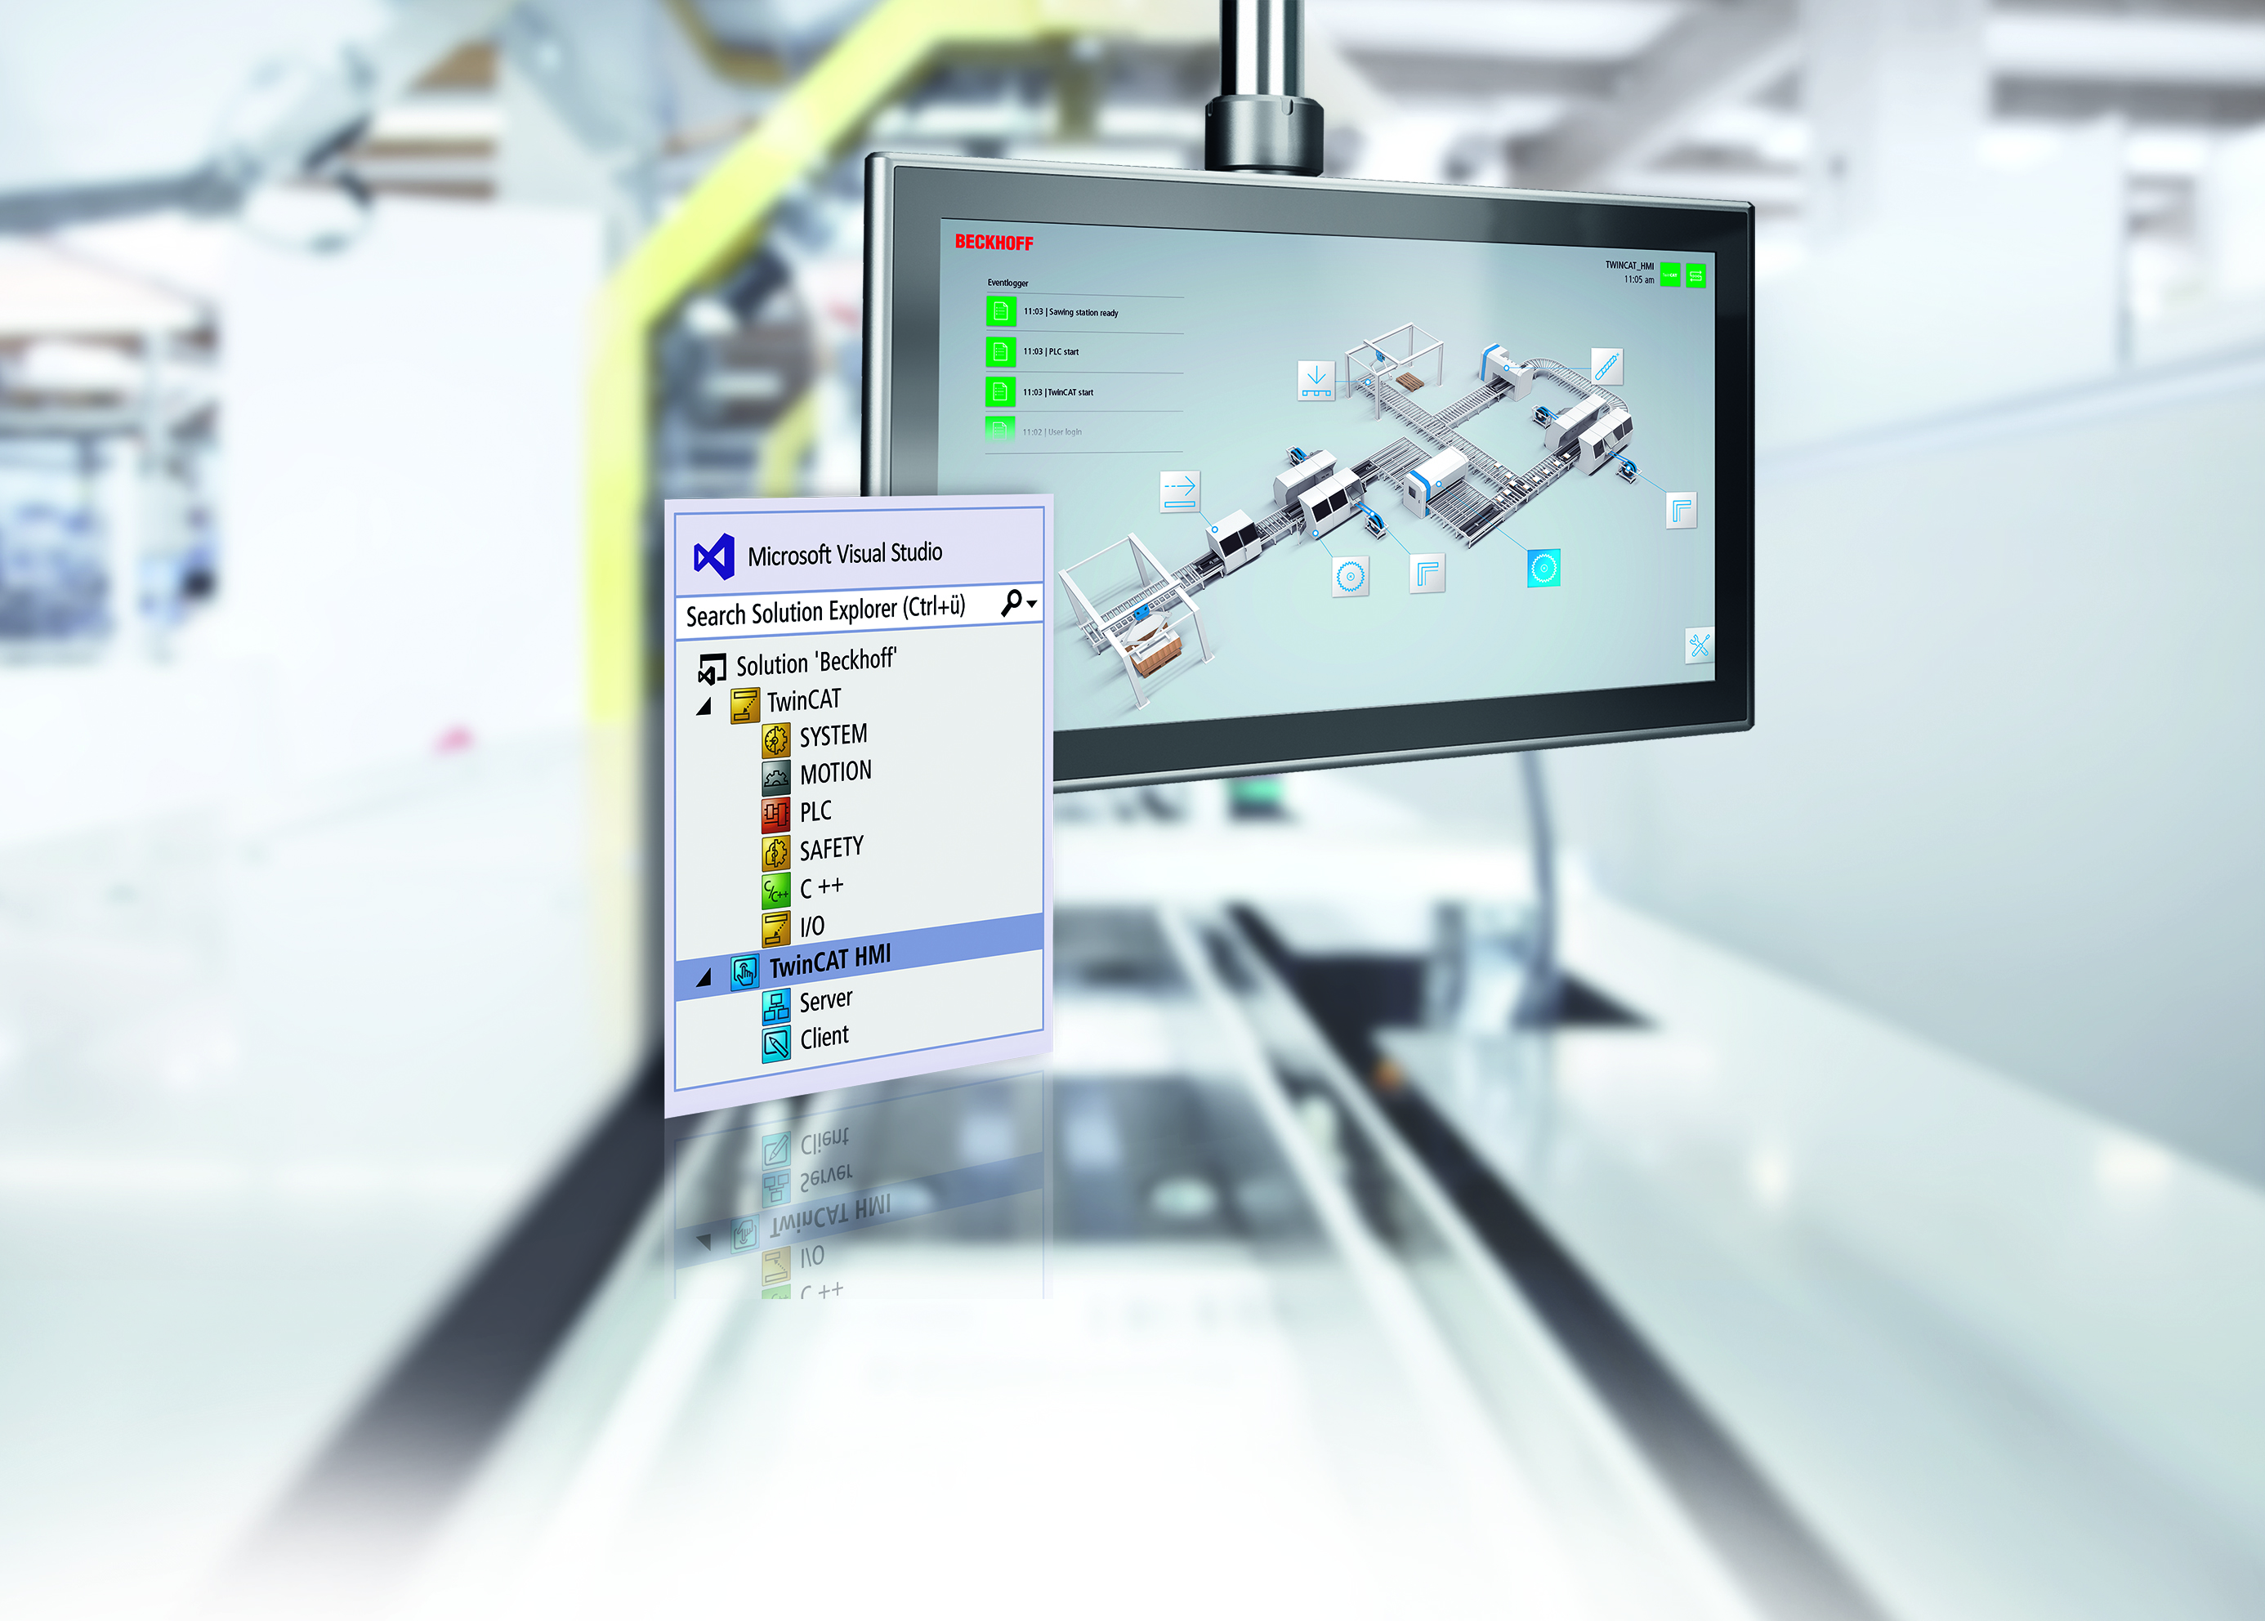
TwinCAT HMI Resource Requirement
Dev Vajaria
Applications Specialist

Slide 2
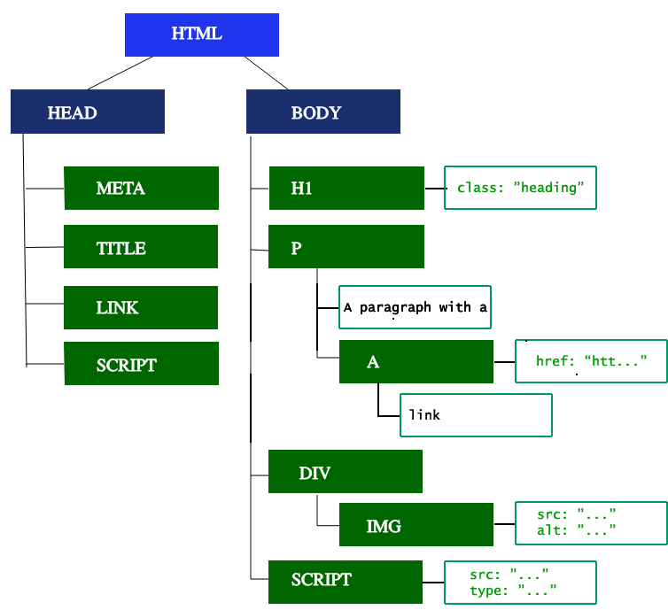
TwinCAT HMI Resource Requirement DOM & CSSOM
DOM – Document Object Model
Tree reflects the relationships & hierarchies between different elements
HTML is parsed to construct tree
More no. of nodes -> longer time to build DOM
CSSOM – CSS Object Model
CSS rules from files are converted into tree – typically faster process than DOM

Slide 3
TwinCAT HMI Resource Requirement Rendering
Style
Layout
Paint
List of visible nodes compiled into a tree
Size & position of each node is determined
Each box is converted to pixel values on screen
All this requires CPU resources

Slide 4
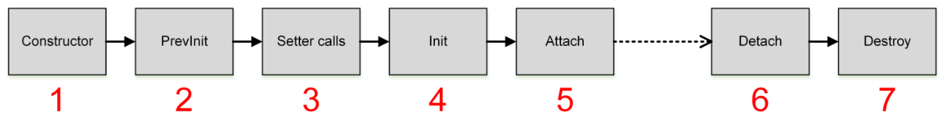
TwinCAT HMI Resource Requirement Control lifecycle
Controls are instantiated
Attributes are set and have valid values
Controls are attached to DOM
Controls removed from DOM (page switching)
Memory deallocated from controls
Memory is required when controls are in DOM

Slide 5

TwinCAT HMI Resource Requirement Million-Dollar Question
What Performance Class PC do I need for my HMI application?
Loading pages requires CPU
Objects on a webpage require memory
More images, pdfs -> more RAM consumption
Animations require CPU
Canvas elements (charts) require CPU
Websocket traffic (bindings) uses CPU
More frequent data reads/writes -> higher CPU load
Open Websocket connections use RAM to store info
More bindings on page -> more RAM consumption
..
..

Slide 6
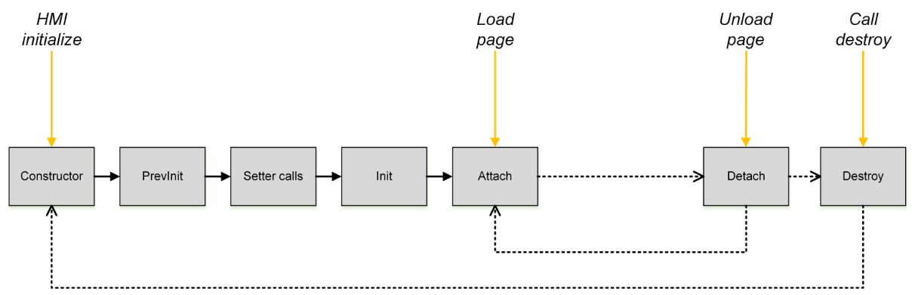
TwinCAT HMI Resource Requirement KeepAlive & Preloading
Preloading loads all controls on HMI initialize and keeps them in browser cache (RAM & Disk)
Slow startup; faster switching
KeepAlive keeps controls in memory when page is switched out
Fast startup; slow first load of each page; faster switching

Slide 7
TwinCAT HMI Resource Requirement Million-Dollar Question
What Performance Class PC do I need for my HMI application?
Atom Processors offer slower processing speeds
Beckhoff PCs with Atom CPUs should not be used for graphic-heavy applications
Browsers use resources available to Windows
Beckhoff PCs with 2 cores should not be used if TC will occupy one core
No way of assigning CPU resources specifically to browser – it will use from whatever is available to Windows
P40 PCs can work for lighter applications (testing needed with customer application)
P50+ PCs are recommended for most HMI applications
Higher RAM option useful to offload some processing by using Preload / KeepAlive

Slide 8
TwinCAT HMI Resource Requirement Testing Tips
Virtual machines with low RAM configuration
Beckhoff PCs with isolated cores
Test project with KeepAlive and Preload (more RAM usage) vs. Default config (more CPU usage when switching pages)
Task Manager can provide quick feedback on CPU usage

Slide 9
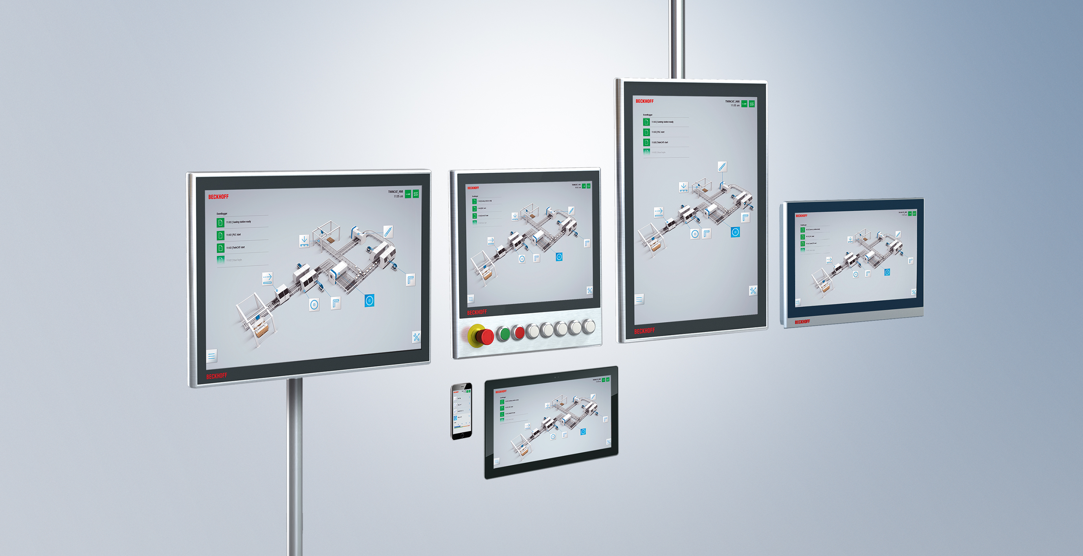
TwinCAT HMI Resource Requirement Questions?

